Slide 1
Reverse Engineering
The Crash Course

Slide 2





Hi!
I am Satria Ady Pradana
Community Leader
of
Reversing.ID
xathrya
https://xathrya.id
@xathrya
Reversing.ID
Revealing the Truth through Breaking Things

Slide 3
Disclaimer
This presentation is intended for educational purposes only.
Reverse engineering of copyrighted material is illegal an might cause you a direct or indirect consequence. We have no responsibility of anything you do after learning this.

Slide 4
What do you think of
Reverse Engineering?

Slide 5
Explaining Reversing
Originally used in the context of mechanical engineering
Breaks down an existing object or system to its construction and then rebuild it based on new demand.
Extracting knowledge or design information from anything man-made and reproducing it or reproduce anything based on the extracted information.

Slide 6

Reversing = Solving Puzzles

Slide 8
Motivation
Interfacing
Improve documentation shortcomings
Bug Fixing
Creation of unlicensed duplicates
Repurposing
Finding security bugs
For fun!

Slide 9
Common Practice
Some popular and commonly used practice or operation

Slide 10
Resource Modification (Modding)
Control Flow Bypass
Code Caving

Slide 11
Resource Modification (Modding)
Modify the resource of application
Icon
Menu
Layout
Sprite

Slide 12
Control Flow Bypass
Alter program flow
Force program to takes (or leaves) intended action.
Jump over the protection mechanism

Slide 13
Code Caving
Writing code to specific region of application (or process’ memory)
Fast and easy
No need for source
In conjunction of Function Trampoline.

Slide 14
Basic Knowledge

Slide 15
The Language
Depend on the target of reversing.
Each programming languages might have unique trait or characteristic.
Channel in Go
Two classes of programming language: native, interpreted.

Slide 16
Assembly
Primitive of Processors operations
Complex operation is decomposed to various instructions
Constrained by processors’ architecture

Slide 17
The Executable Format
Application has a format.
Identify by magic number.
Structured and has some sections for data, code, resource, etc.
Function might be provided by foreign module (ex: DLL), list of imported function is maintained.

Slide 18
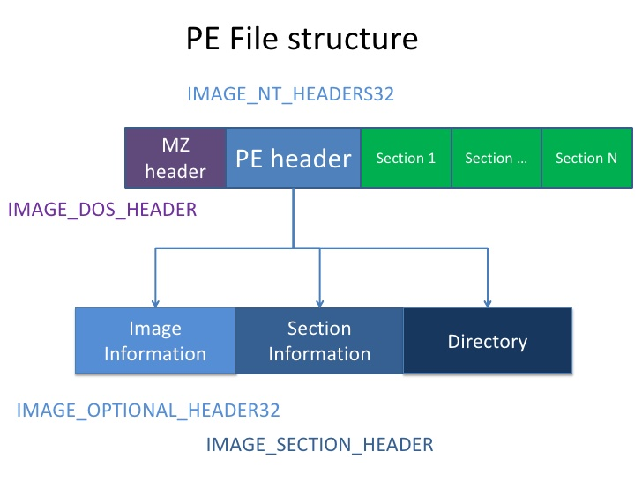

Slide 19
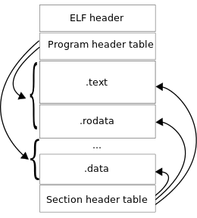

Slide 20
Design Pattern
Software is divided into conceptual module and working together.
Repeatable solution to a commonly occurring problem in a software design.

Slide 21
Common Code Base
Library
Framework

Slide 22
Common Tools
Breaking the system to fine-grain components

Slide 23
Hex Editor
Disassembler
Debugger
Resource Editor

Slide 24
Hex Editor
Display the content of file as collection of hex formatted-data and modify part of them.
Find pattern and occurrence.

Slide 25
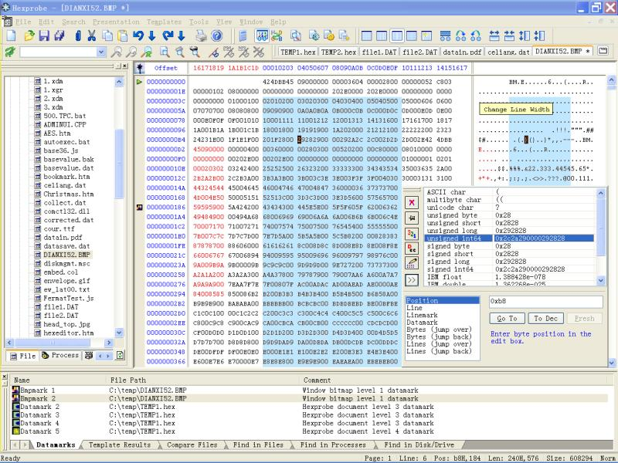

Slide 26
Disassembler
Transform stream of hex bytes to its assembly representation.
Resolve data and resource, referred by the code.

Slide 27
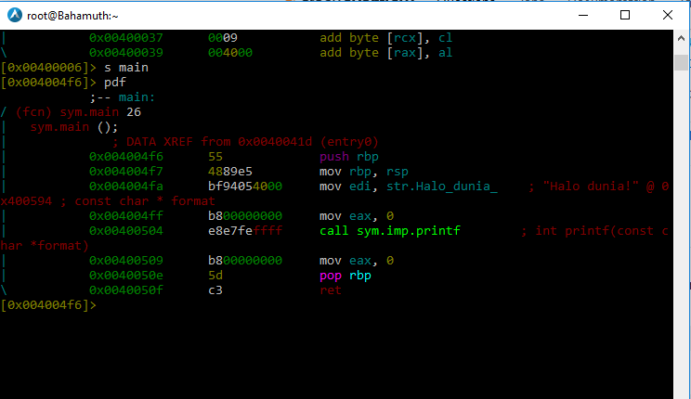

Slide 28
Debugger
Test or debug other (target) program
Examine program condition at runtime.
Modify code or data section.
Modify CPU state
Alter control flow

Slide 29
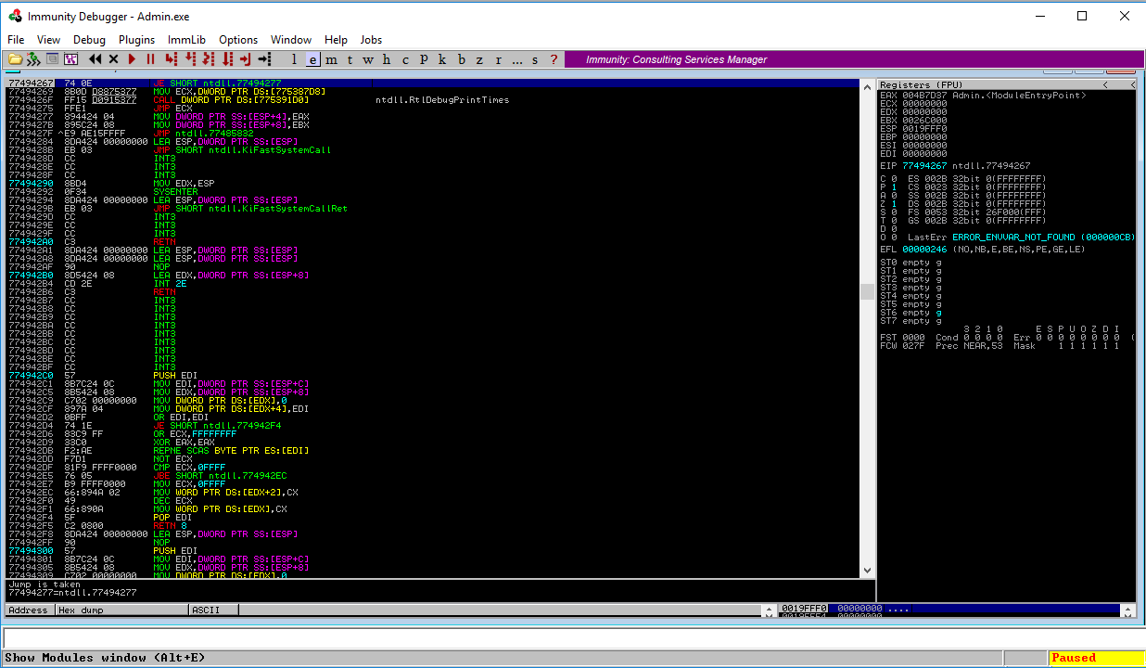

Slide 30
Common Process in Reversing
Some popular activity and flow

Slide 31
Identify
Disassembly
Decompile if possible
Debug
Patch

Slide 32
End of Game.

